Slide 1
Boat Electrical Systems
A short seminar on the various systems on a cruising yacht that carry electrical currents.
Craig Johnston
3/1/25

Slide 2
Outline
The systems view of a cruising sailboat
Electrical subsystems
120/240 VAC
Low voltage DC
Navionics
Corrosion
Lightning
Systems interactions
Break
DC systems
Separating starting and house loads
Switching
Charging
Circuit Protection
Battery chemistry

Slide 3
An Engineer’s View of a Cruising Boat
A Collection of Systems:
Rig and Sails
Auxiliary Power
Electrical
Hydraulic
Plumbing
Safety

Slide 4
Shorepower
AC sytems on the boat

Slide 5
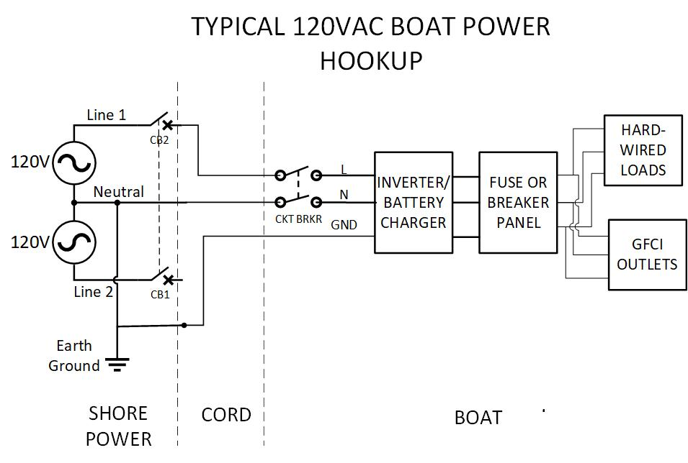

Slide 6
AC systems variations
Many different AC system hookups are possible. Factors affecting the system design are:
What is the total power needed? 30A/120V will do for most cruising boats, but adding air conditioning might require 50A.
Is operation from 240V needed for foreign ports? This suggests adding an isolation transformer with 120/240V primary.
Will the system include an AC genset?
Are the battery charger and inverter combined or separate? The AC loads must be disconnected from shore power when the inverter or genset are in operation.

Slide 7
WIRING BASICS
All wires have resistance. When a current I flows through a wire with a resistance R, there are two effects:
There is a voltage drop V over the wire: V=I∙R
Power is dissipated in the wire, heating it: P=V∙I=I²R
If the wire gets too hot, it will melt or cause a fire.
A fuse or circuit breaker is used to interrupt current above a save level.
A fuse or circuit breaker can also be used to protect a load
The trip value must be the LOWER of the wire or load rating.

Slide 8
120/240 Wiring Safe Practices
Use correct size and type of wire
Stranded (NOT solid) copper wire, preferably tinned
#14 AWG for up to 15Amps
#12 for up to 20A
#10 for 30A
Use correct terminations
Crimped circular lugs or crimped sleeves
NO solder
NO wire nuts

Slide 9
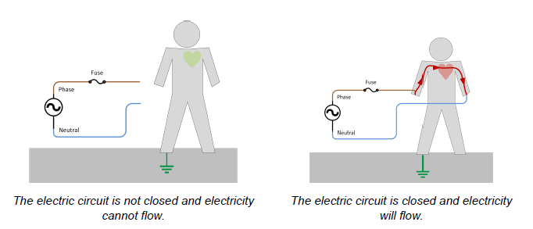
SHOCK HAZARD

Slide 10
SHOCK HAZARD
Skin resistance varies from over 100kΩ to under 10kΩ, with results ranging from a tingle to a lethal shock.

Slide 11
GFCI PROTECTION FOR A MORE LIKELY SHOCK HAZARD

Slide 12
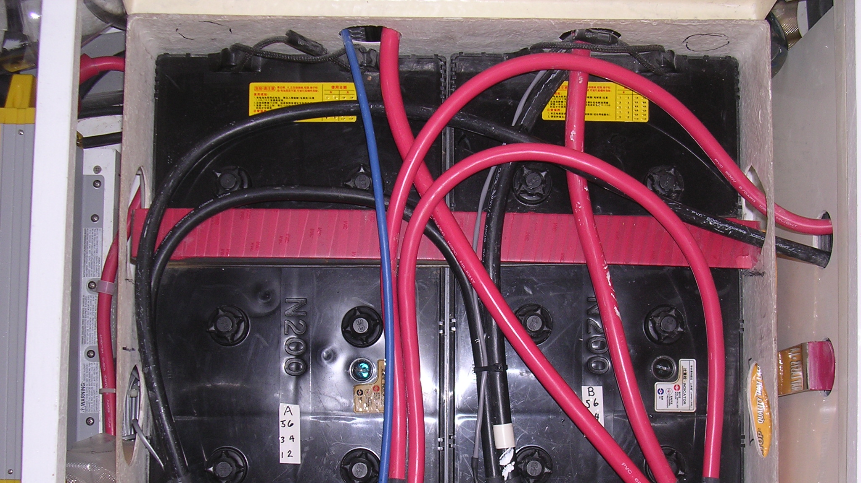
DC SYSTEMS

Slide 13
12/24VDC Systems – key components
Batteries to store energy
One or more to power house loads—lights, electronics, fridge, heating
A separate battery to start the engine
Various sources to charge batteries:
AC line-powered battery chargers
Propulsion engine alternator
Dedicated DC generator
Solar panels
Wind or water turbines
Notes:
Ask about peoples concerns about batteries and DC systems

Slide 14
12/24VDC Concerns
Enough power for anticipated loads and time between charging.
Accidental discharge of engine starting battery.
Hazard is primarily from overheating of wires and connections.
Secondary hazard from flammable fumes and chemical spills depending on battery type.
Risk of heavy batteries coming adrift in heavy weather.

Slide 15
More Wiring Basics
Wire type: fine-stranded, tinned copper. (Solid wire is prone to breakage from vibration. Tinned is necessary to prevent corrosion.)
Terminations: crimped lugs on barrier strips or crimped ferrules on eurostyle connector blocks.
Wet locations require completely sealed terminations—adhesive-lined heat shrink over closed-end lugs.
Wires bundled, tie-wrapped and fastened to the bulkhead to prevent vibration damage.

Slide 16
Wire termination
Use the correct size lug for the wire.
Use only CLOSED-ENDED lugs.
Crimp with proper tool
For any wire or cable that may see moisture, cover with adhesive-lined heat shrink tubing.

Slide 17
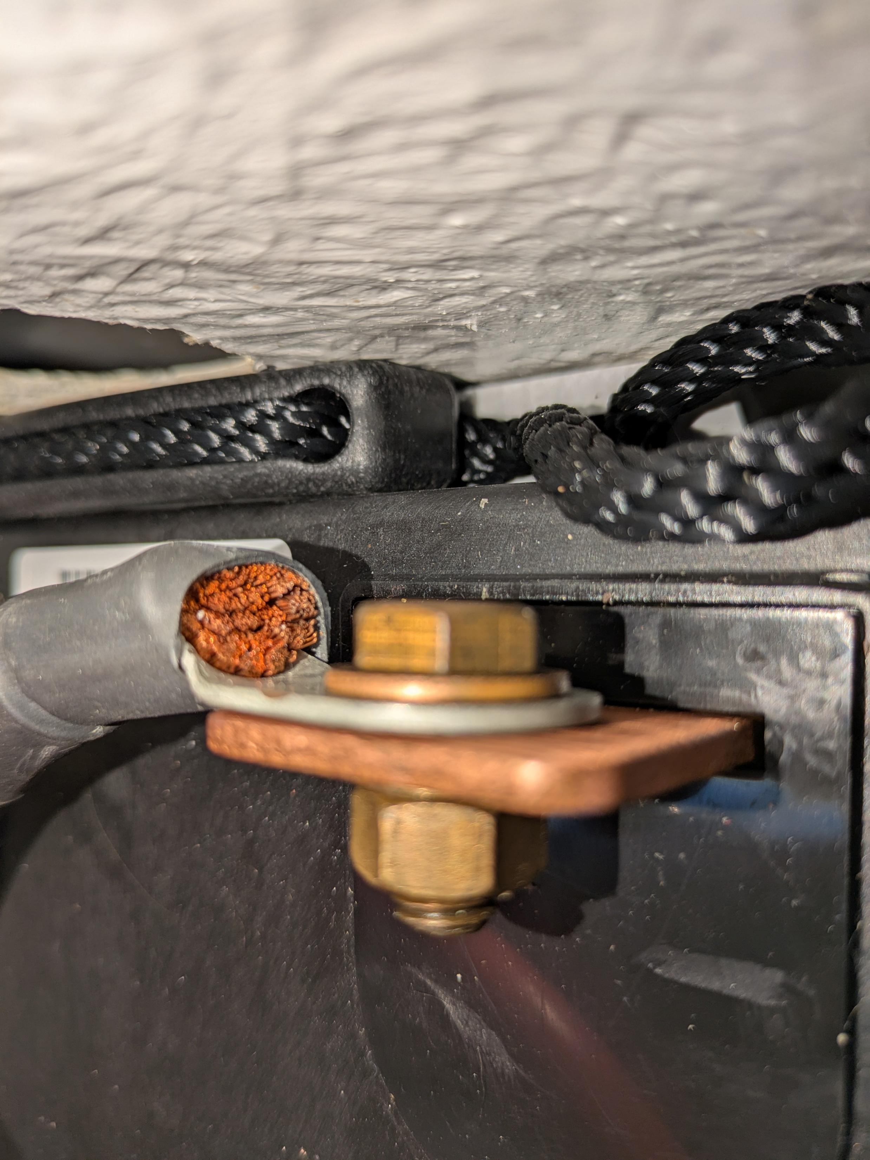
😧
Oh, nooooooo...
Notes:
An open-ended lug is like a sponge.

Slide 18
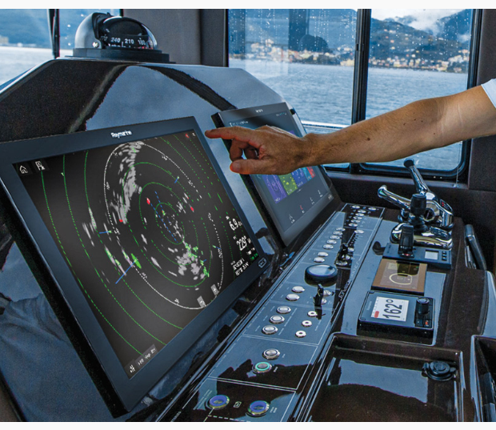
NAVIONICS

Slide 19
Moving Data
Old: NEMA 0183 serial comms, RS-232 ports, and often proprietary systems
New: NEMA 2000 serial bus, a backbone connecting instruments, plotters, radar, engine data, etc.
Needs clean DC power—connected to 12V ground only in one place.
12V battery voltage varies from <12V to >14.5V (during charging). Will the electronics safely handle this? (possible problems with TV and appliances not designed for cars or boats.)
Notes:
4kbits/sec okay for simple data, not fast enough for fast heading data needed for a smart autopilot.

Slide 20
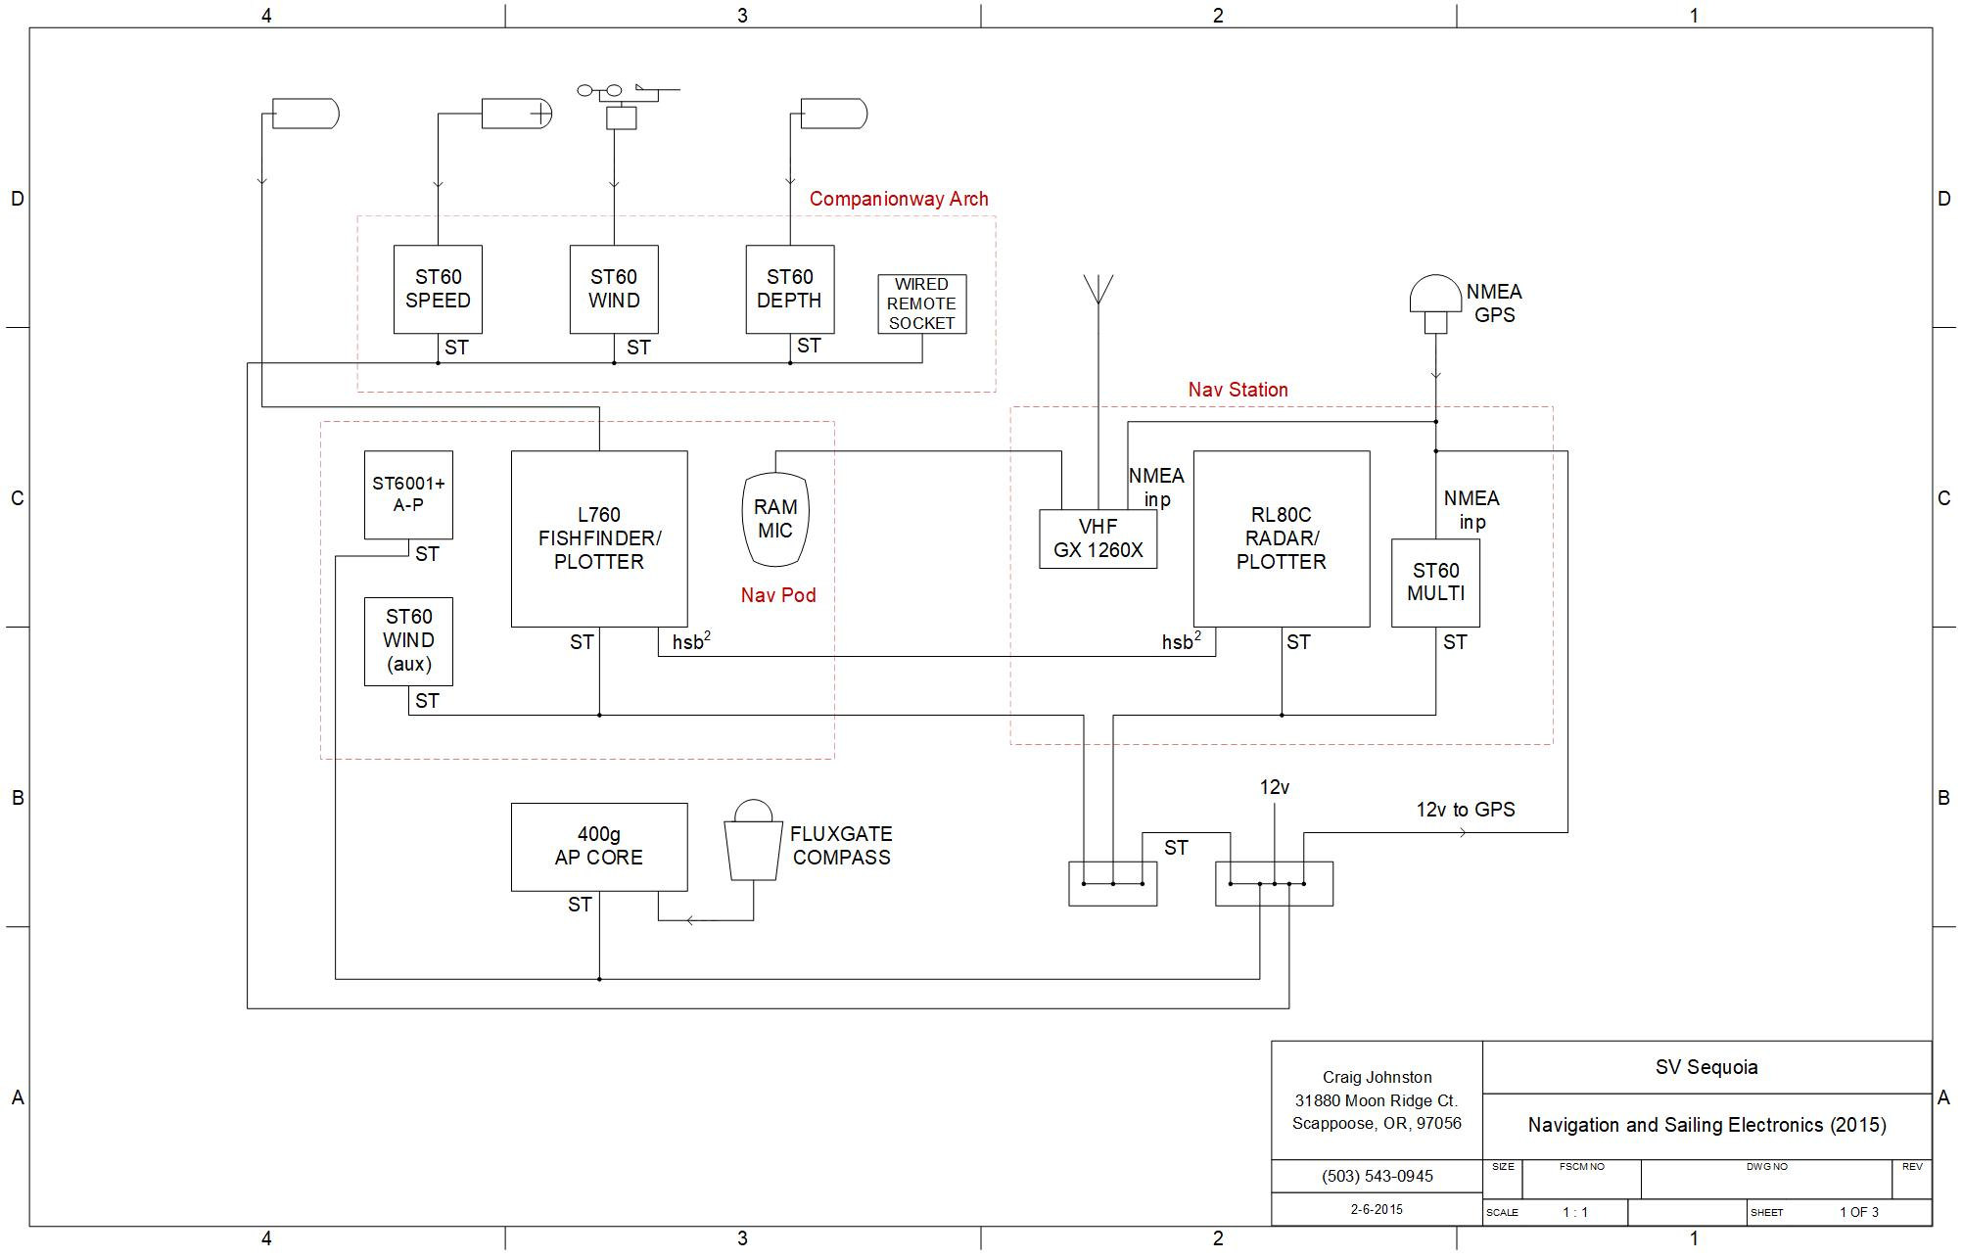
Notes:
It’s useful to make a wiring diagram of the navionics subsystem.

Slide 21
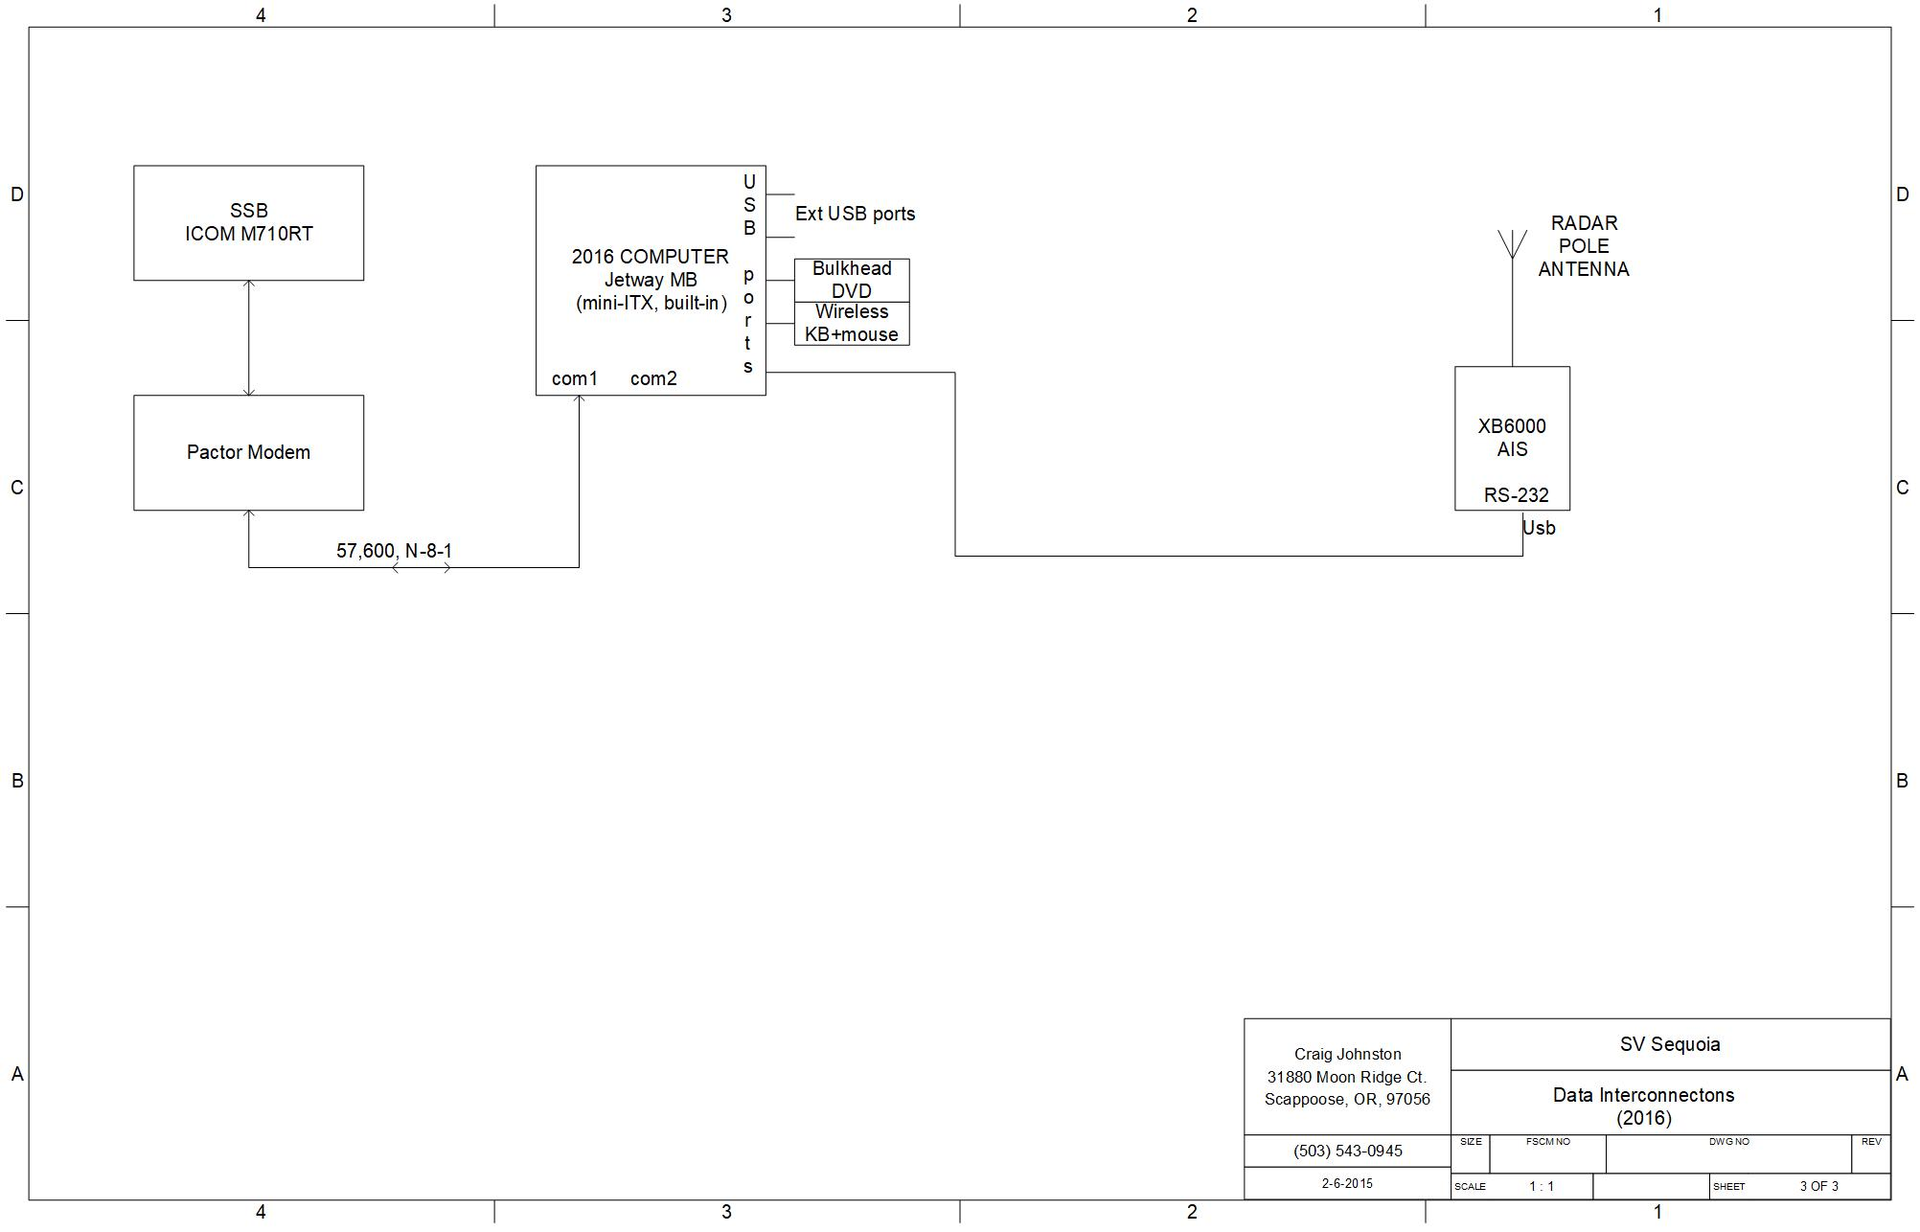
Notes:
An also a diagram of specialized systems, like the computer and its commection to the SSB and AIS

Slide 22
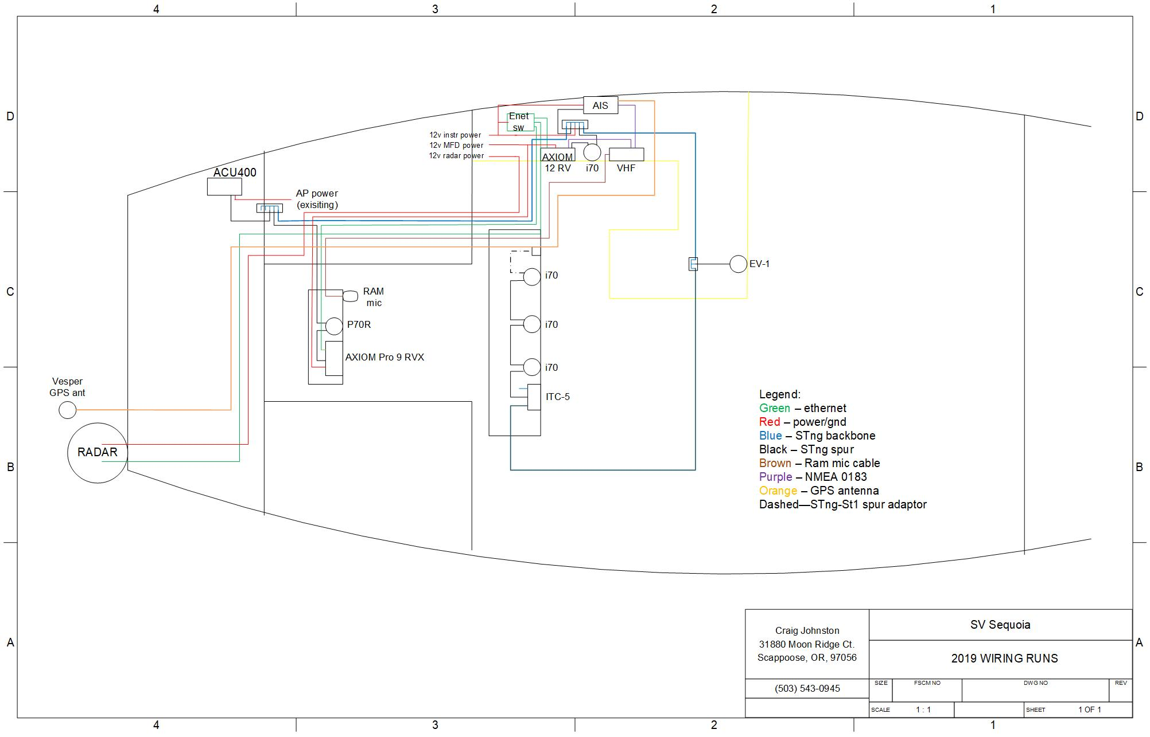
Notes:
A “geographic” wiring diagram can be very helpful.

Slide 23
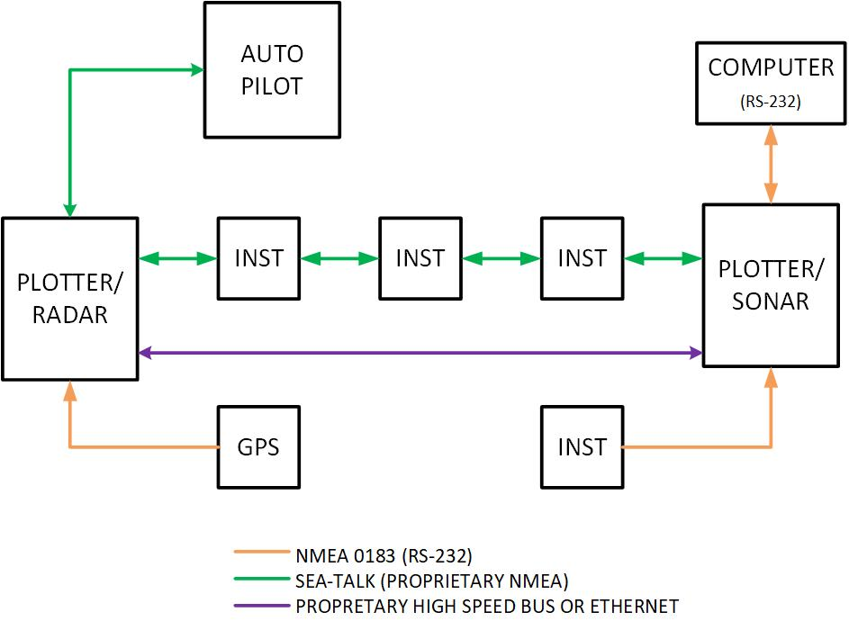
OLD NEMA 0183 LIMITED TO POINT-TO-POINT CONNECTIONS

Slide 24
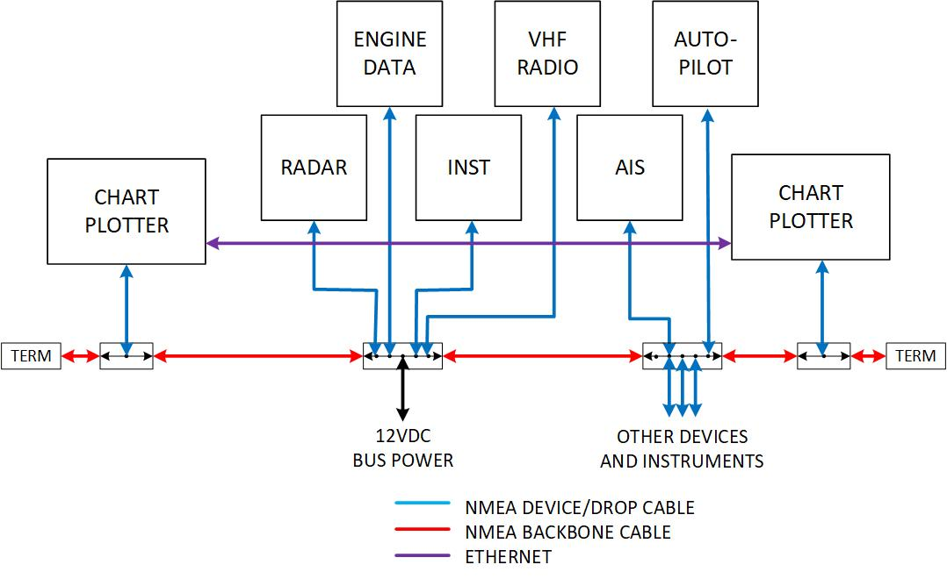
MODERN NEMA 2000 DATA BUS
ALLOWS FOR MANY DIFFERENT DEVICES TO BE INTERCONNECTED

Slide 25
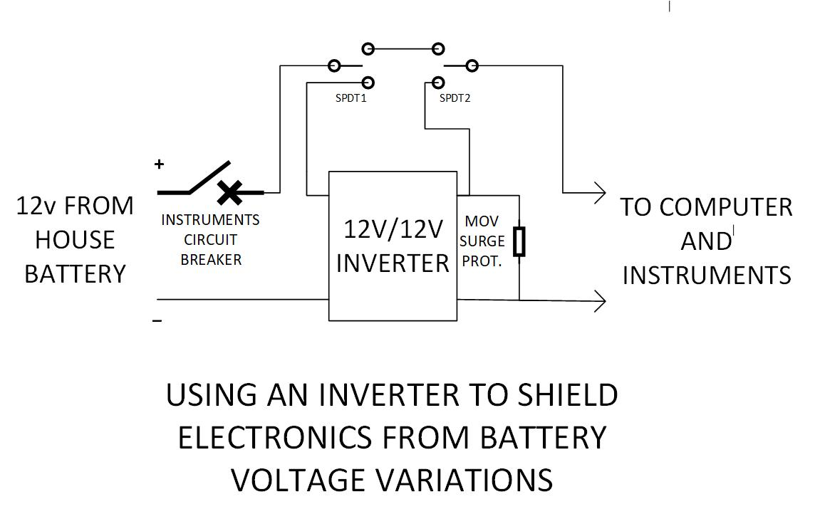

Slide 26
Galvanic Corrosion

Slide 27
Metals with differing electrochemical potential form batteries. In the presence of an electrolyte, current flows from the anode, causing corrosion.

Slide 28
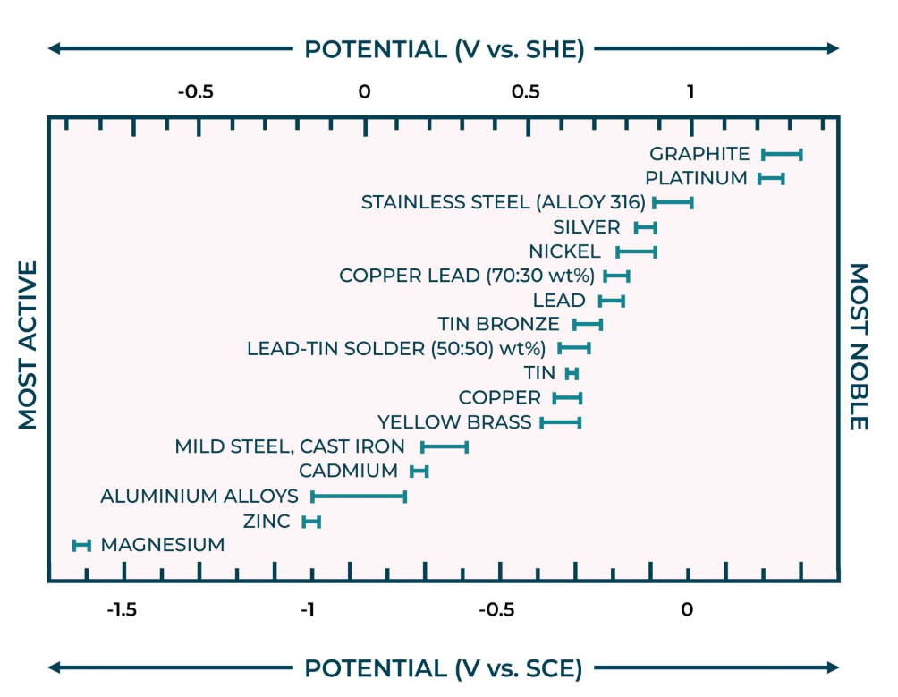
The more active (anodic) metal corrodes.
Moisture is part of he process
Seawater accelerates it.
The greater the potential difference, the more corrosion
<0.2V for no corrosion.

Slide 29
PREVENTING GALVANIC CORROSION FROM DISSIMILAR METALS
Use a sacrificial zinc anode.
Connect the zinc to the prop shaft, prop and strut and engine
Bond engine intake through-hulls
Bonding of isolated bronze through-hulls isn’t needed.
When putting stainless steel screws into aluminum, always use TefGel, lanolin, or a thorough coating of thread-locker.
Never allow copper to directly contact aluminum—loose pennies sink ships…if they have aluminum hulls…

Slide 30
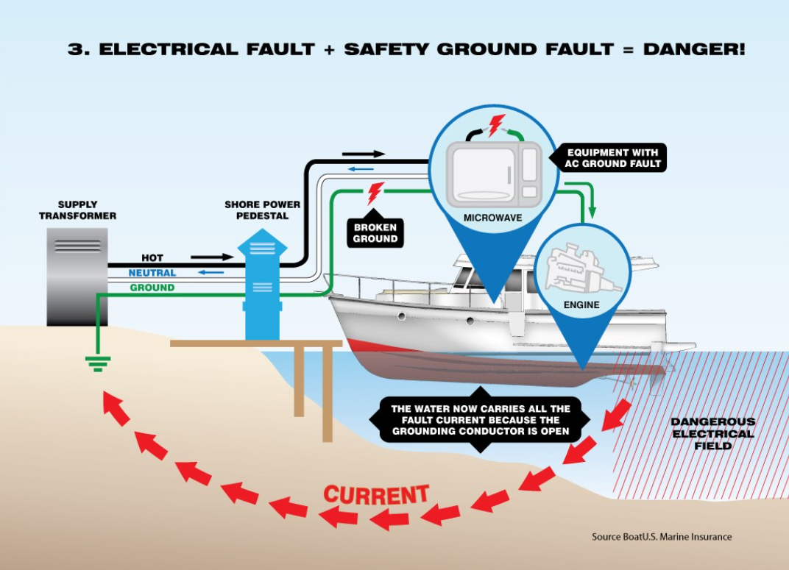
THE “HOT” MARINA PROBLEM

Slide 31
The “hot” marina also causes electrolysis
Your neighbor’s boat leaks AC current into the water.
This current flows through your prop/shaft/zinc back to the shore through the green ground wire. This will corrode underwater metal even with a connected zinc.
OR the current flows into a through-hull at the bow, through the bonding wire back to the engine and 12V ground, and back to shore. This will corrode even an otherwise stable bronze fitting.

Slide 32
“HOT” MARINA PROTECTIONS
Isolate
Isolate your boat’s ground with a isolation transformer or a ground isolator.
Do NOT bond everything
Do NOT bond through-hulls to the zinc if not otherwise connected to engine ground.
Measure leakage
Use a clamp-on AC ammeter to measure the current in your AND your neighbors shore power cords. Any reading over 60 mA is a cause for concern (the meter needs to have a resolution of at least 0.010A per digit).

Slide 33
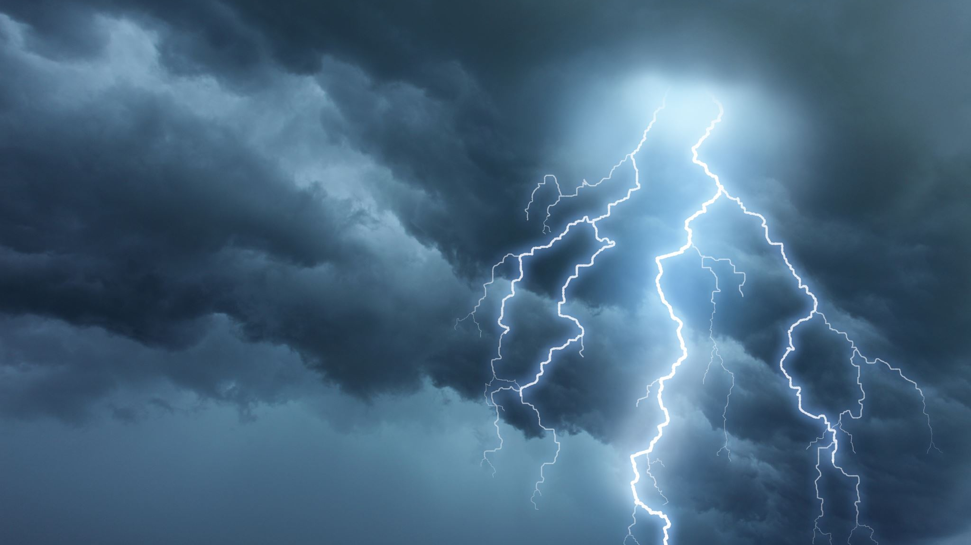
LIGHTNING PROTECTION

Slide 34
LIGHTNING – WHAT IS IT?
Electrons build a negative charge in clouds
Voltage to ground of 100MV up to 1000MV
A stroke to ground follows the shortest, lowest resistance path.
The stroke ionizes the air, resulting in a conductive path
A peak current of 20,000A to over 100,000A flows
Typical duration is on the order of 1 microsecond

Slide 35
LIGHTNING –is it a real problem?
Most common in the tropics: Florida, Caribbean, Australia, or sailing the ITCZ.
On the coast of Florida, it is common to have over 1000 lightning strikes per square mile per year. Boat damage is common.
A Catalina 42 was struck at River Place marina on the Willamette, resulting in hundreds of small hull perforations. The boat was eventually totaled.

Slide 36
Danger!
Your boat’s mast is the “easiest” path to ground.
The current travels down the mast and rigging and then takes the shortest path into the water.
If there is no connection from the bottom of the mast to the water, the voltage will rise to the level necessary to penetrate the hull.
The path may also go through through-hull fittings, tanks or down the shrouds.
High pulse currents will magnetically couple into adjacent wiring, creating voltage spikes on DC and radio leads of 1000’s of volts.

Slide 37
Results of lightning strikes on sailboats
All masthead antennas and sensors vaporized.
Catastrophic failure of radios, instruments, plotters, lights, appliances, batteries, engine generator and starter.
Holes in the hole, ranging from melted through-hulls to hundreds of pin holes and exploded bulkheads.
Lethal shock hazard to people on board.

Slide 38
The ZONE of PROTECTION

Slide 39
PROTECTION FROM CATASTROPHIC DAMAGE: Create a low resistance path from the masthead to the water.
Aluminum masts are good conductors; wood and carbon fiber need a #4 wire.
#4 wire from mast base to and external keel
OR #6 wire to an external ground plate or strap of at least 2 sq.ft.
#6 wire from chainplates to external ground.
Also bond lifelines.

Slide 40
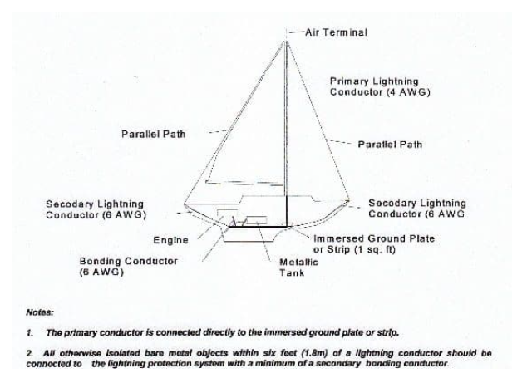

Slide 41
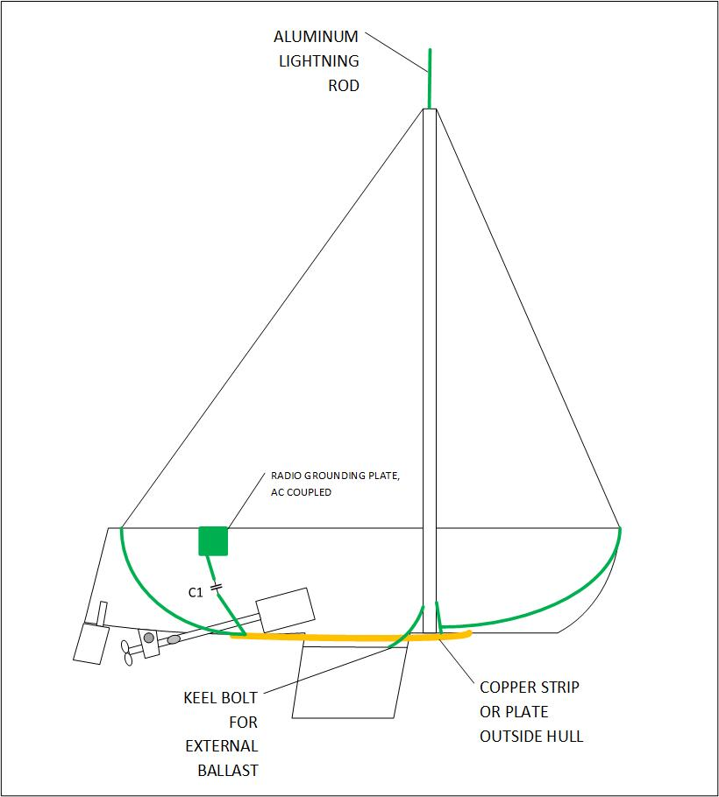
Lightning protection on s/v Sequoia
1/2 inch aluminum rod at mast head
2” x 13’ Cu strip on hull
#4 AWG wire from mast
#6 AWG wires from stays
2” foil strip from radio grounds

Slide 42
Lightning ground on Sequoia
A copper strip 2” side x 13’ long, 3/16” thick.
2 heavy (1/2”) bronze bolts connect to the interior of the hull, one near the mast, the other aft near the electronics bay.
#6 wires connect to the mast base and shrouds at the forward end.
A ground strap connects the aft bolt to the ground plate under the radio antenna switches/lightning clamps.

Slide 43
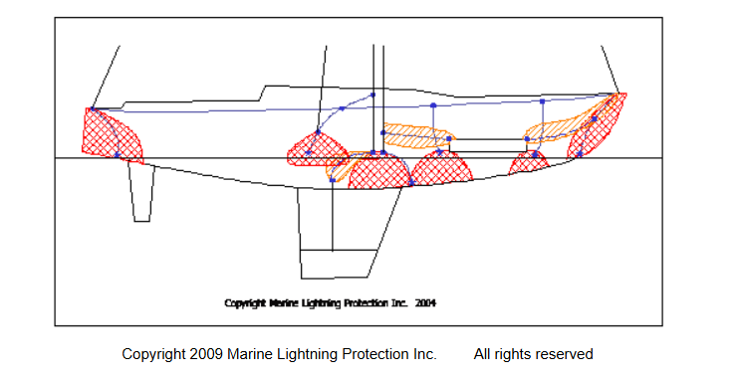
Marine Lightning Protection, Inc. system
a loop conductor around the perimeter of the boat at deck level
a network of bonding conductors at deck level connected to the loop conductor
multiple external main conductors
internal main conductors only where necessary
a grounding terminal at the end of each main conductor.

Slide 44
PROTECTION FROM SECONDARY LIGHTNING DAMAGE: Isolate and protect other systems
Navionics:
Use a 12v/12v inverter for computer and instruments
Multiple transient suppressors in 12V power.
Use a Faraday cage for portable electronics.
Alternator:
transient suppressor across output
Fuse battery terminals
Radios
Lightning clamped disconnect switches
Or just disconnect antenna wires during a storm

Slide 45
Electrical Systems Interactions
120VAC safety ground.
12VDC ground
Electrolysis connections
Radio grounds
Lightning grounds

Slide 46
120VAC SAFETY GROUND (green wire)
Because 120V is present on your boat, the green wire ground MUST be connected to 12v (battery) common ground.
But hooking to shore power causes problems with DC electrolysis or AC leakage from nearby boats.
The green wire ground on the boat needs to be isolated from shore power ground with either a ground isolator or isolation transformer.

Slide 47
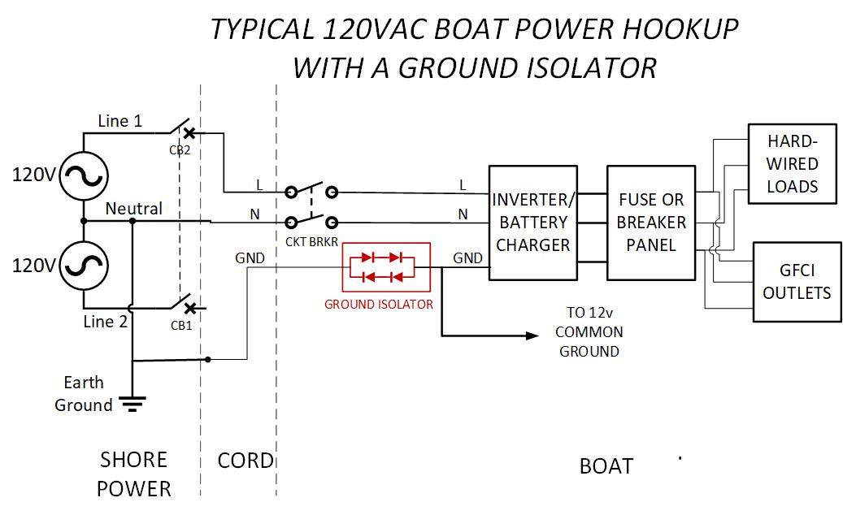

Slide 48
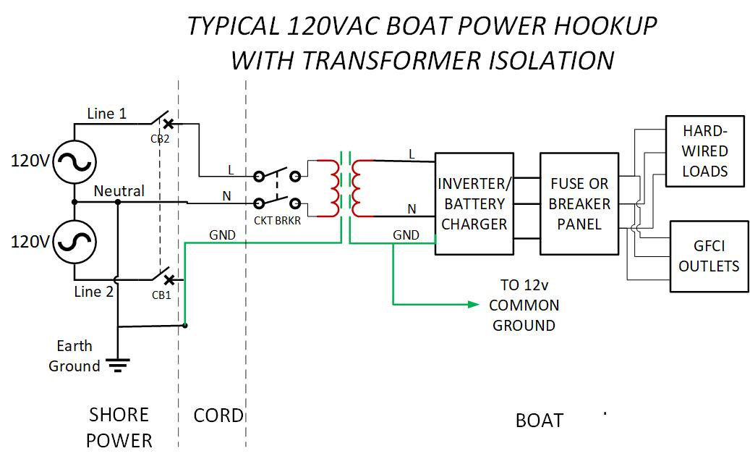

Slide 49
12VDC GROUND
Only ONE common ground point, typically a bus bar with multiple connections.
Both engine starting and house battery negative terminals connected here. (If a battery monitor is part of the system, its shunt will be between the battery negative and the ground bus.
Engine connected (carries alternator output)

Slide 50
BASIC DC GROUND CONNECTIONS

Slide 51
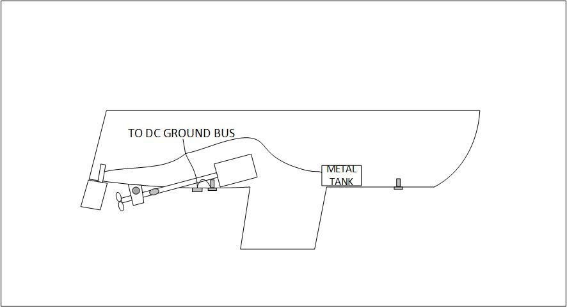
ELECTROLYSIS PREVENTION

Slide 52
LIGHTNING GROUND ISOLATION
SHORTEST PATH TO WATER –no bends or angles >15°
SEPARATE CONNECTIONS FOR RIGGING, LIFELINES
NO DC CONNECTION TO 12V GROUND OR BONDING –this means the masthead VHF antenna needs DC isolation as well as a lightning clamp

Slide 53
Lightning protection on s/v Sequoia
1/2 inch aluminum rod at mast head
2” x 13’ Cu strip on hull
#4 AWG wire from mast
#6 AWG wires from stays
2” foil strip from radio grounds

Slide 54
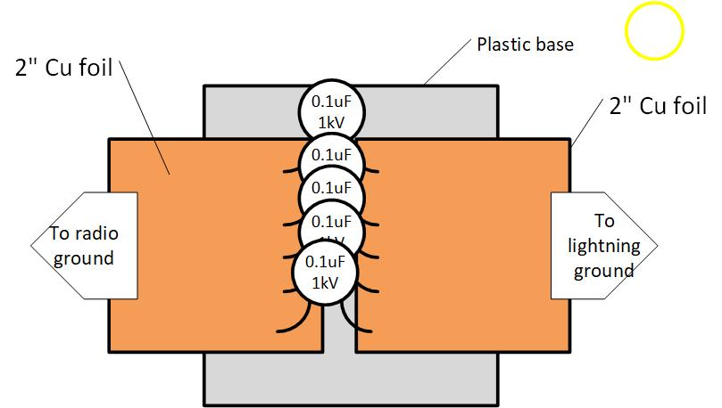
DC decoupling for a lightning ground

Slide 55
Radio Grounds
The VHF radio doesn’t need a separate ground. But if it is mounted on the mast, it will connect the mast to 12VDC ground unless there is a dc isolator.
For the SSB HF radio, the ground is half of the antenna and vital to proper performance.
Connect to all large metal objects—engine, tanks, etc. But this will create ground loops and adversely affect performance on some frequencies.
OR use an external ground plate (Dynaplate).
OR use long foil strip inside hull at water level (Best!)

Slide 56
Added HF radio grounds: 2 alternatives

Slide 57
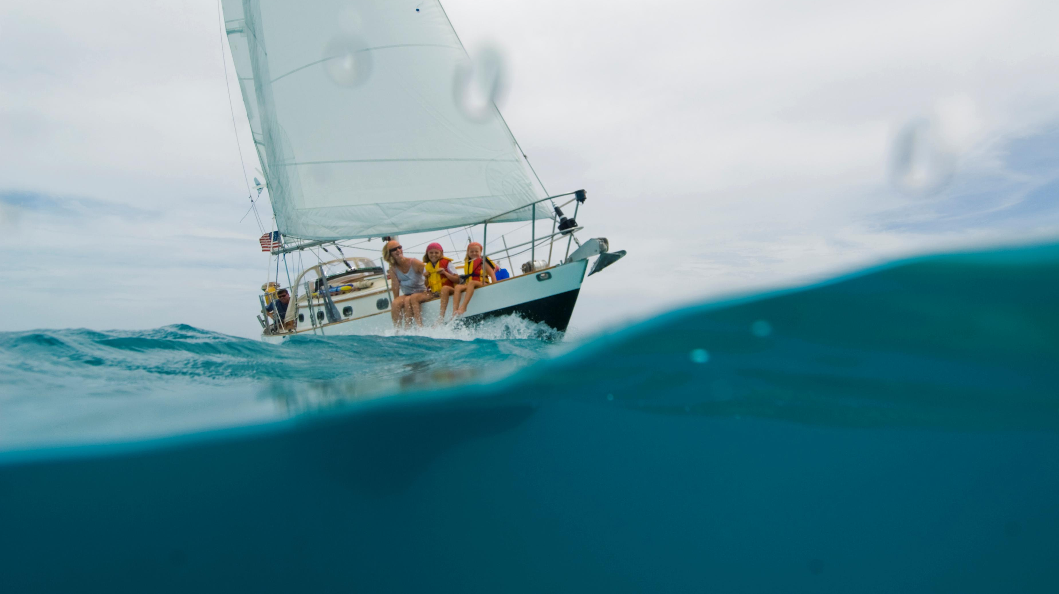
-- Break --

Slide 58
DC SYSTEMS

Slide 59
Basic Questions
Why do cruising boats have multiple batteries?
What problems does that cause?
How to solve?

Slide 60
It starts with adding a second battery…

Slide 61
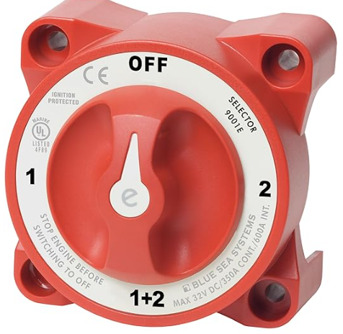
Notes:
How many of you have had one of these?

Slide 62
The troublesome ON-OFF-BOTH switch
Notes:
Two lead in, one going out. What kind of a problem have you had with this setup?

Slide 63
Off – on – combine switch

Slide 64
Safer and more economical
Notes:
Is this an improvement? What is wrong with this setup?

Slide 65
Automating the charging
Notes:
Now you don’t have to remember to change the switch position.

Slide 66
The most flexibility

Slide 67
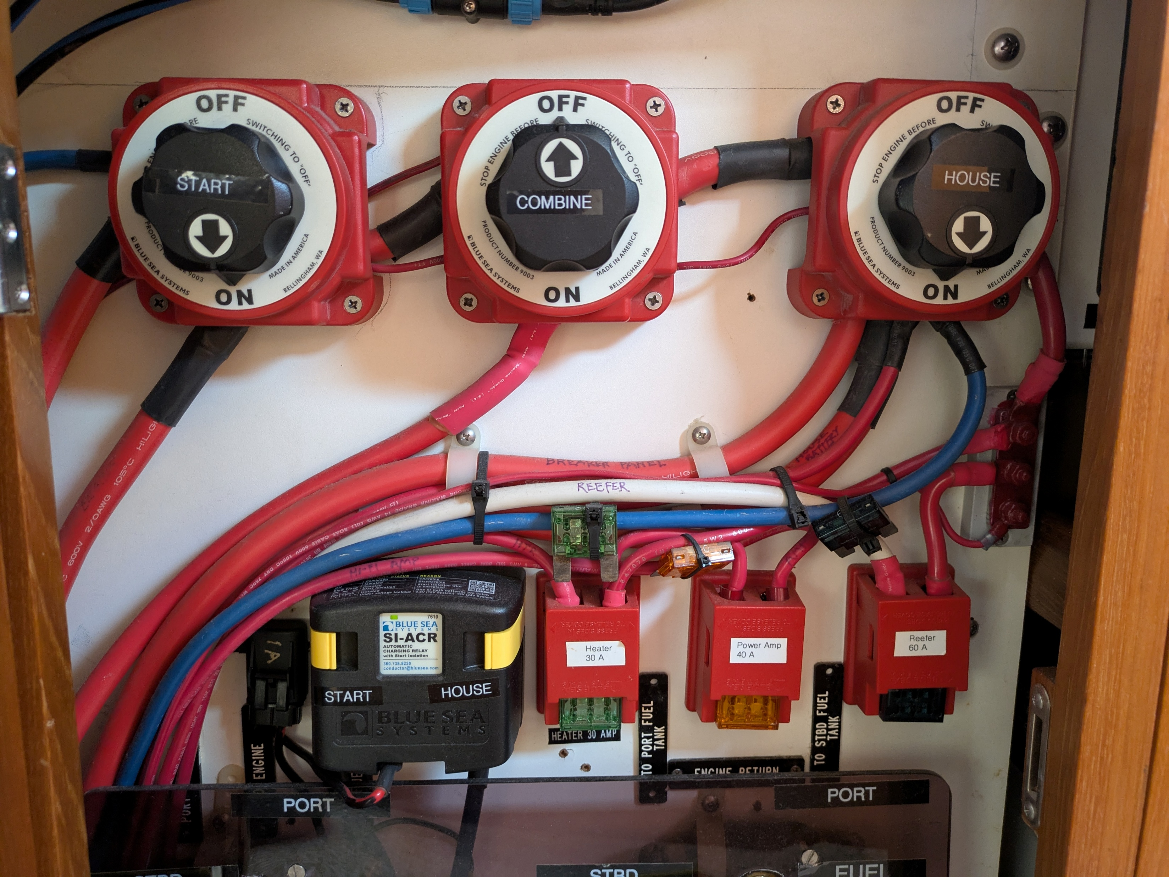

Slide 68
Battery Charging
Multiple charging sources are possible:
Engine alternator
Shorepower battery charger
Solar panels
Wind turbine
Water powered alternator
Separate charging engine/alternator
Each needs to have an output appropriate for the battery chemistry

Slide 70
Switched and un-switched loads
Some loads don’t want to be switched off by the battery switch. They each need a fuse or a circuit breaker:
Bilge pump
Diesel cabin heater
Anchor windless
Refrigerator compressor
Lighter loads are fed by the breaker/fuse panel through the battery switch.
Principal charging sources typically bypass the battery switch

Slide 72
Circuit Protection
Fuses and circuit breakers

Slide 73
Why?
To protect the wires from overheating.
AWG wire size | Max current
18 | 7A
14 | 15A
12 | 20A
10 | 30A
8 | 40A
4 | 70A
2 | 95A
2/0 | 225A
4/0 | 325A
The fuse or breaker must have a rating no larger than for the smallest wire it feeds.
Notes:
These ratings are for bundles of 3 or less. A single wire is rated for a higher current. Wire size is also chosen fo minimize voltage drop.

Slide 74
Why?
2. To protect a load that is overloaded or shorted.
Example: An Espar 5DL diesel cabin heater calls for a fuse or circuit breaker of 25A. Thus, the minimum wire size is AWG #10. In addition, they specify that if the collective length of the wires (+ and -) is more than 5m, the wire should be #8. The fuse would still be 25A.
Example: A Lewmar V3 anchor windlass calls for #2 wire for total runs of 23-50 ft., or #0 for 50-70 ft. The specified circuit protection is 110A. (This is higher than the limit for #2 wire in a bundle of 2-3, but okay for a single wire, so the wires can’t be part of a cable or in a conduit.)
The fuse or breaker must have a rating no larger specified for the load.

Slide 75
Fuses
Fuses are essentially a section of low melting point wire calibrated to melt above a certain current.
They are rated for:
Current – the max current they will pass continuously
Voltage – the max voltage they will interrupt
Interrupt rating – the max current they will break
Fuses are rated as fast or slow-blow. But either type will probably carry 110% of its current rating continuously, 135% for 1 hour, and 200% for 2 minutes.
Fast blow fuses are for sensitive electronics, slow blow for motors and circuits with high in-rush currents.
Notes:
The Victron manual has an excellent guide to the various types of fuses.

Slide 76
Circuit Breakers
Circuit breakers are resettable and often double as switches in boats.
Circuit breakers are either thermal, magnetic, or a combination of the two. Low voltage breakers in boats are typically thermal.
Magnetic breakers can respond very quickly to large fault currents. (These are the kind in your house.)
Breakers have similar ratings to fuses for Amperage, Voltage, and max interrupt current.

Slide 77
Fuse and circuit breaker examples

Slide 79
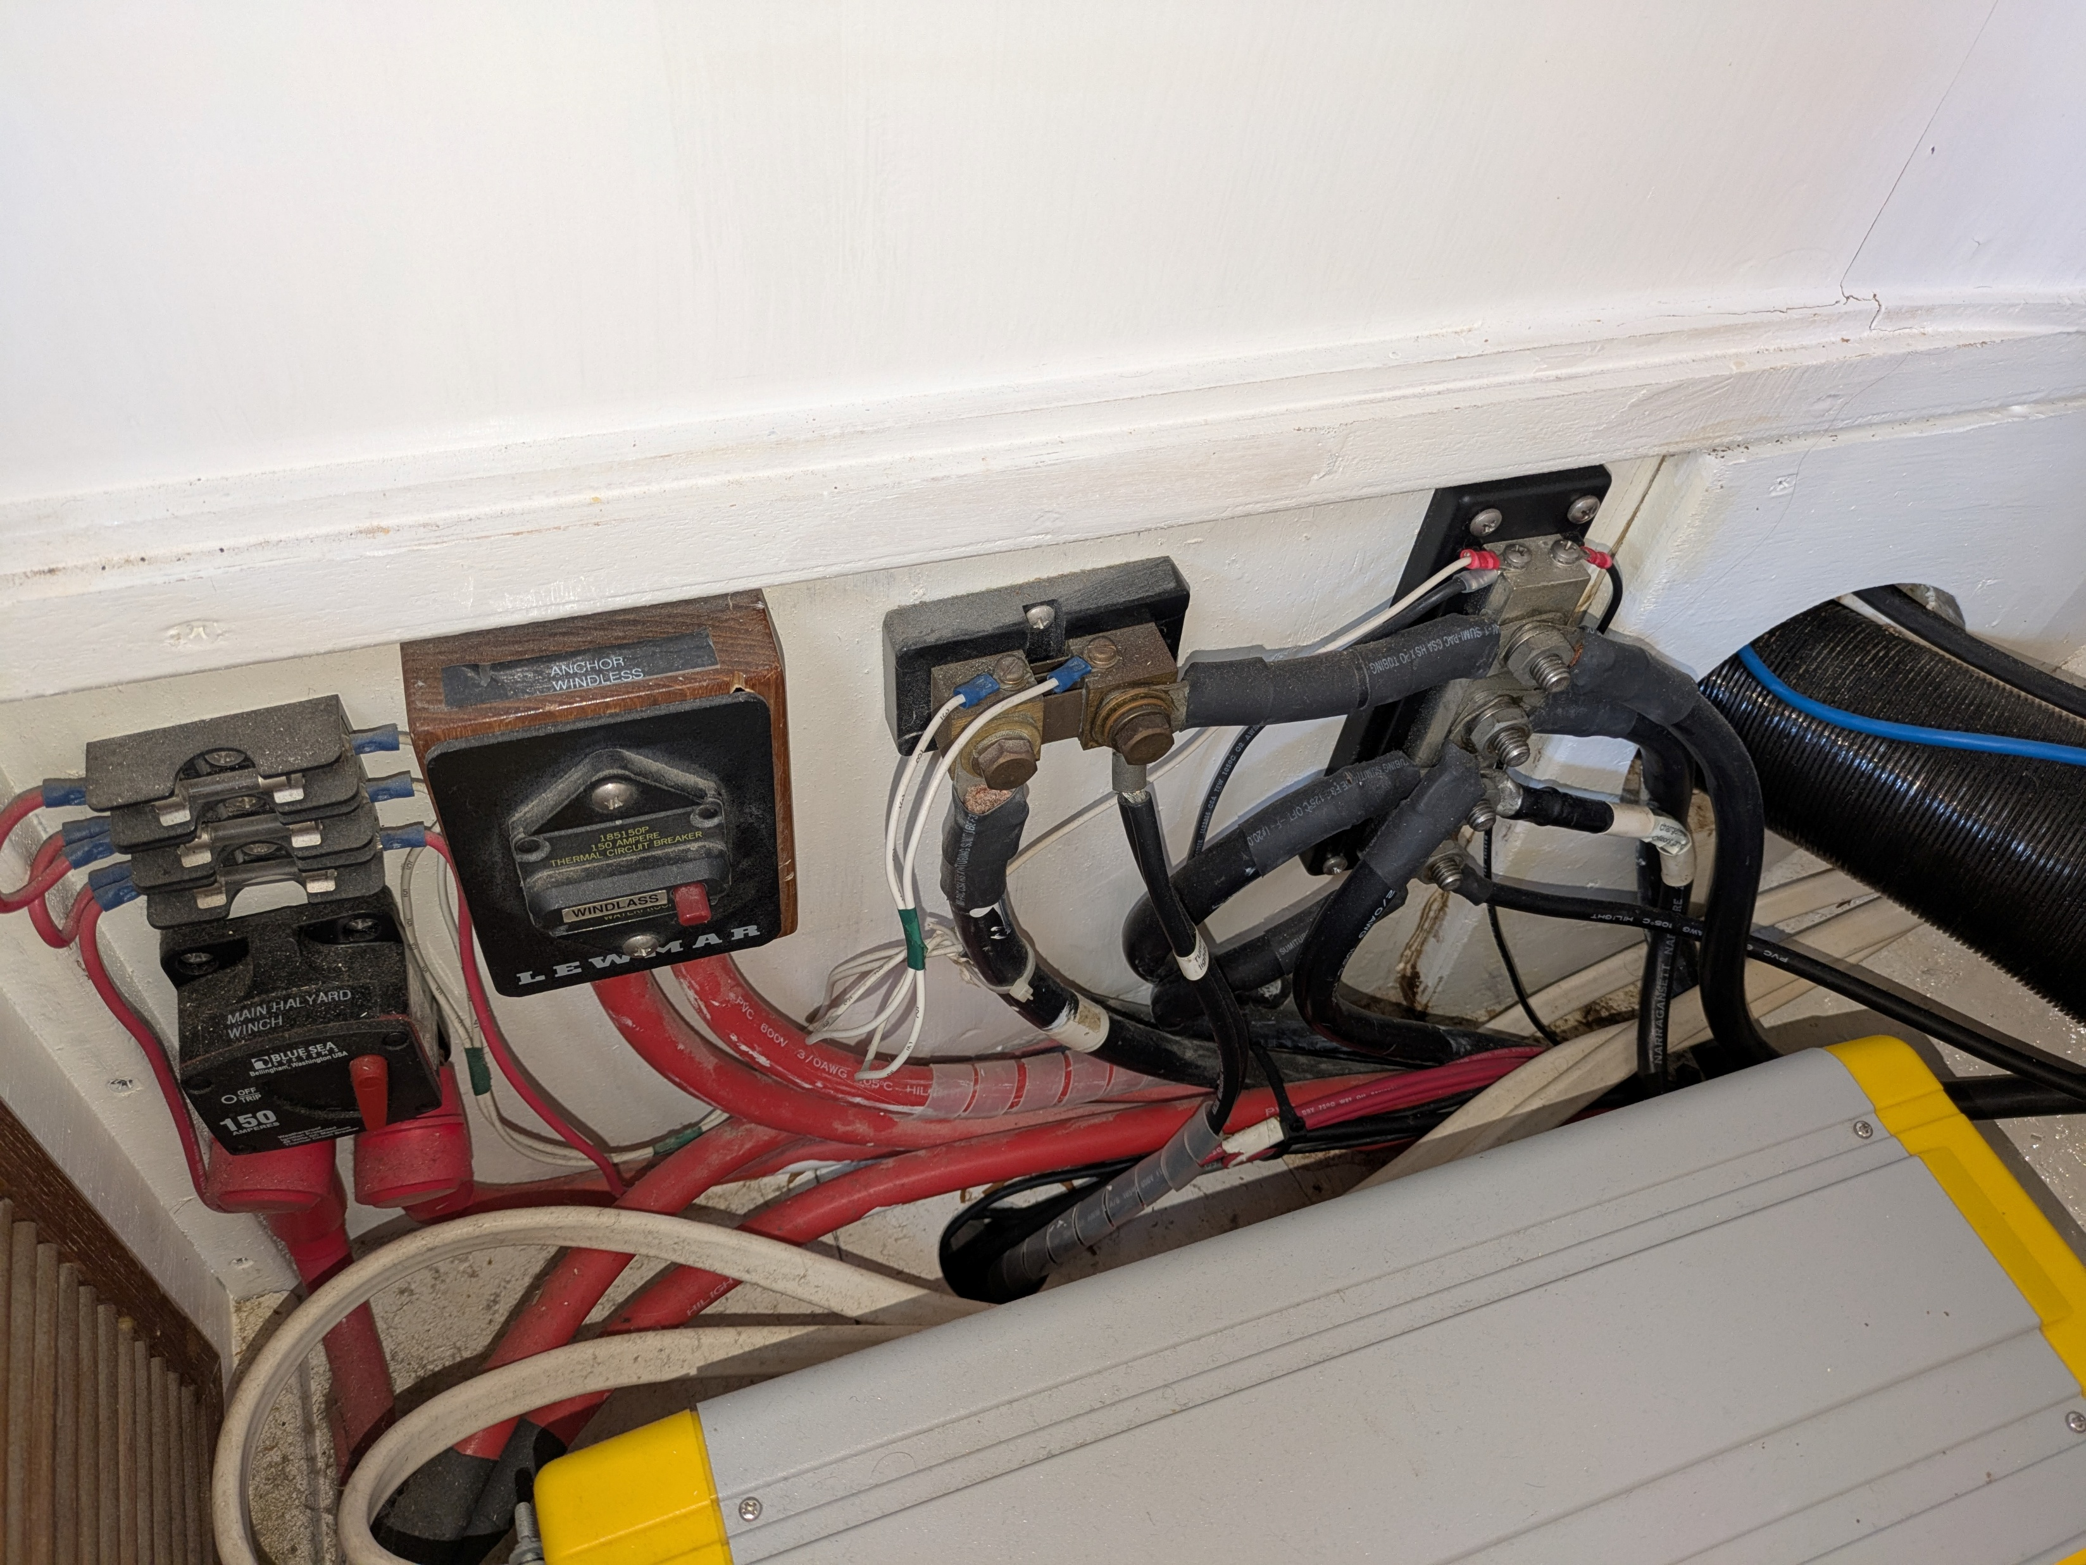

Slide 80
Batteries
An overview

Slide 81
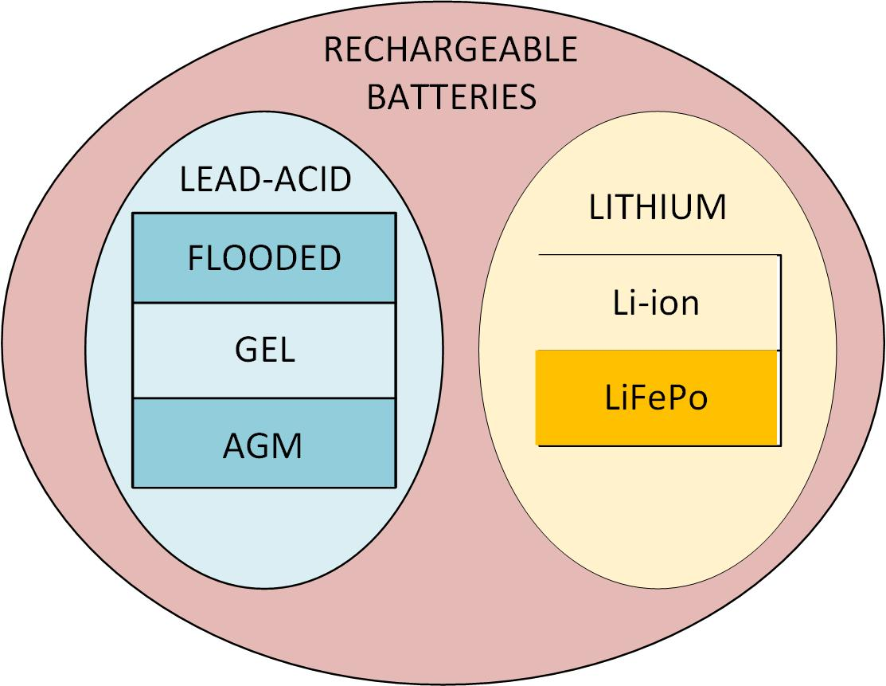

Slide 82
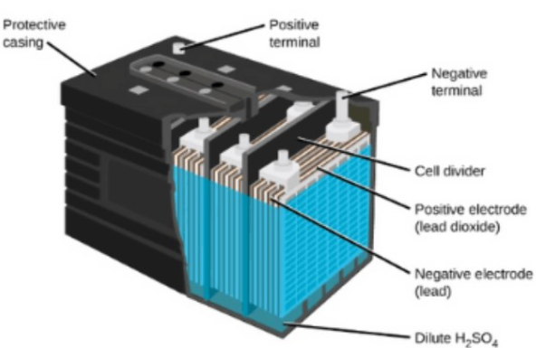
Common Features of 12V
Lead-acid batteries:
Plates of lead and lead dioxide.
Sulfuric acid electrolyte
Series connected cells, producing ~2.14V per cell when fully charged

Slide 83
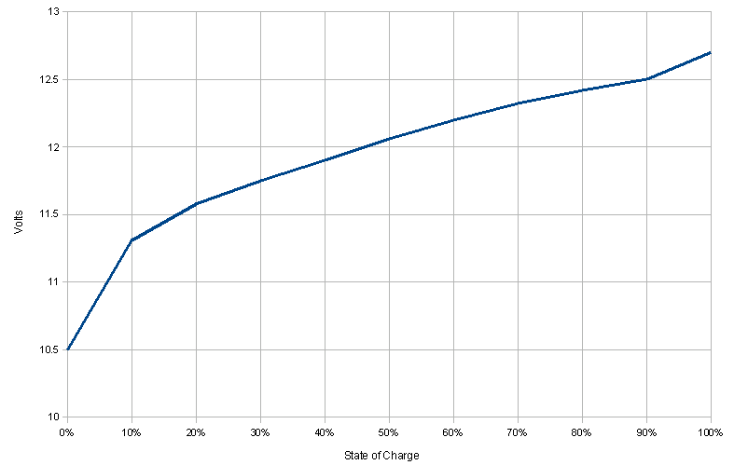
Notes:
Voltage vs. state of charge. The battery needs to be disconnected from loads and chargers for 24 hours for an accurate reading.

Slide 84
Deep discharge damages capacity and life.
Notes:
All lead-acid batteries are heavily affected by the size of the load. The rated capacity is for C/20.

Slide 85
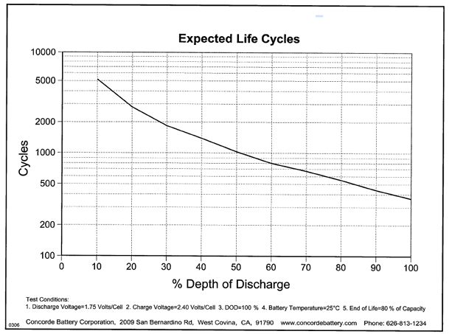
LIFELINE AGM
EXPECTED
LIFE CYCLES

Slide 86
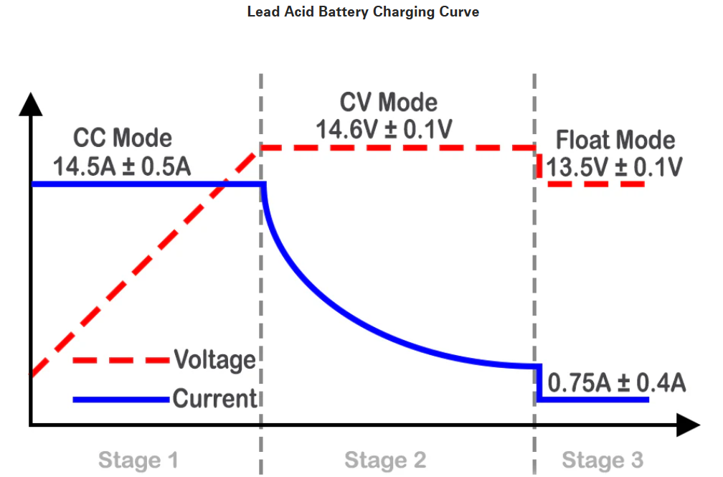
Notes:
Typical multi-stage charger profile.

Slide 87
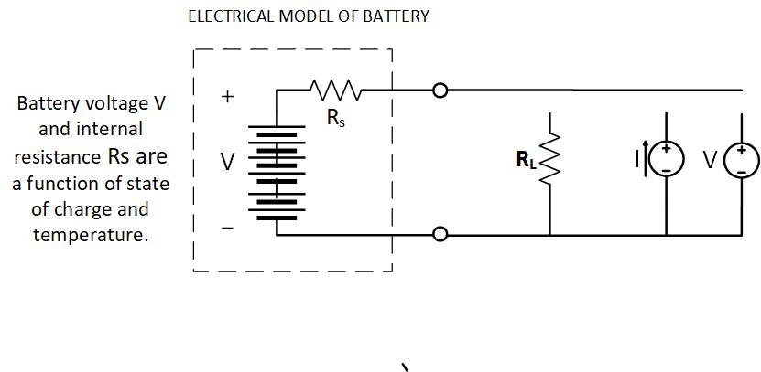

Slide 88
TEMPERATURE EFFECTS
Temperature effect on voltage
Temperature effect on internal resistance
14,04
13.68
13.32
Notes:
At low temperatures, the voltage drops, the internal resistance increases, and the capacity is decreased.

Slide 89
Battery charger requirements
Multi-stage profile for quicker charging and longer battery life.
Profile adjustable for flooded, gel or AGM type or lithium.
Compensated for battery temperature

Slide 90
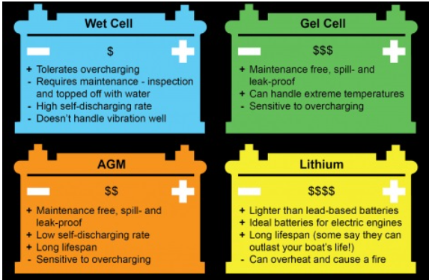

Slide 91
Lithium batteries (LiFePO₄) aka LFP
Lithium ferrophosphate cathode, graphite anode.
Electrolyte of lithiumhexaflouride in an organic solvent
Working cell voltage of 3.0-3.3V (4 cells for a “12V” battery)
Max cell charged voltage of 3.60-3.65V (14.4-14.6V)
Sealed, maintenance-free construction
Lighter, more energy dense than lead-acid
Flatter discharge curve
100% discharge doesn’t affect capacity or lifetime.
Inherently safer charging than Li-ion batteries.

Slide 92
Battery Technology Comparison
BATTERY TYPE | OC VOLTAGE @20°C | TEMPCO | SELF-DISCHARGE %/mo. | VOLUMETRIC ENERGY DENSITY (Wh/l) | GRAVIMETRIC ENERGY DENSITY (Wh/KG) | CYCLE LIFE FOR 50% DOD
FLOODED | 12.75 |  | 8 | 20-50 | 30-50 | 450
GEL CEL | 12.85 |  | 4 | 20-50 | 30-50
AGM | 12.85 | −21mV/°C | 4 | 20-50 | 30-50 | 1000
LFP | 12.45 | −1.6mV/°C | 2 | 220 | 90 | >3500

Slide 93
Important Considerations
LEAD-ACID BATTERY
LFP BATTERY
Very heavy
Risk of acid spill and hydrogen gas unless sealed (AGM, Gel)
Less capacity at low temp.
Less capacity at high load.
Shorter lifetime at high temp.
Lighter, smaller
Sealed
Less capacity at low temp
Capacity unaffected by load.
Shorter lifetime at high temp.
Expensive

Slide 94
Boat Electrical Seminar
March 1, 2025
Suggested references:
Boatowner’s Mechanical and Electrical Manual, (4th ed.) by Nigel Calder
Wiring Unlimited, Victron Energy
Sailboat Electrical Systems: Improvement, Wiring and Repair, by Don Casey
Understanding Boat Batteries and Battery Charging John. C. Payne
West Marine Advisor—many useful articles
For AGM batteries: Lifeline Batteries Lifeline Technical Manual, https://lifelinebatteries.com/wp-content/uploads/2015/12/6-0101F-Lifeline-Technical-Manual-Final-5-06-19.pdf

